Slide 1
All-Day Breakfast Strategic Analysis
Evaluating Promotion Performance & Path Forward
Prepared for the Regional Manager, Western & Northern Michigan
October 15, 2016 | The Outliers | Costantinos, Obaro, Stephen
Notes:
SPEAKER 1. Thank you for meeting with us. You asked us to help you see through the numbers on All-Day Breakfast before you report to corporate. In the next 15 minutes: our understanding of the problem, what the data shows, what we still need, and our plan to get you a recommendation well before January 1.

Slide 2
Intro
Problem
Data
Insights
Questions
Plan
Executive summary: ADB lifted revenue at launch, but customer traffic has continued to decline and profit is unknown.
+8.6%
Revenue is up, led by McMuffins
Big Mac and Quarter Pounder held up; chicken and fries fell
−4%
Customer traffic vs previous year:
Foot traffic increased by 1.1% in the first quarter, then dropped back to −4% a year by last 8 weeks of data.
?
Profit is unknown:
Each new dollar generated by a breakfast sale coincided with 20 to 40 cents of lost non-breakfast revenue.
Our goal: a clear pull, keep or expand recommendation for you by December 18.
Source: McDonald's weekly sales extract, 64 West Michigan restaurants, Jan 2013 to Aug 2016; team analysis
2
Notes:
SPEAKER 1. The short version. Revenue is up 8.6%, driven by the McMuffins you featured, and Big Mac and Quarter Pounder held up. But the customer gain lasted only one quarter, and we can't yet tell whether it's profitable. Our plan answers that by December 18. Change Data Colors to McDs Colors, Change alignment of top intro / problem data etc to readt from the left.

Slide 3
Intro
Problem
Data
Insights
Questions
Plan
Agenda
1
Problem definition What we heard, and the questions we propose.
2
Data overview What we received.
3
Data assessment What’s missing, and quality.
4
Insights What the numbers show
5
Questions for you And our formal requests
6
Plan and next steps October 15 to January 1
3
Notes:
SPEAKER 1. Six short parts, with time for your questions. Add alignment, lines under each line of description

Slide 4
Intro
Problem
Data
Insights
Questions
Plan
What we heard:
The situation
The decision for corporate
■ 60+ restaurants, about $200M a year
■ Customer traffic down about 5%/yr for 3 years
■ McMuffins featured all day
■ Kitchen equipment is limited
■ Franchisees report mixed results
Pull it
Back to breakfast until 10:30 am
A
B
Keep McMuffins only
Today's all-day menu
C
Expand
Add biscuits and McGriddles
Your question: did All-Day Breakfast work, and which option should the region choose?
Source: kickoff conversation with the regional manager; team analysis
4
Notes:
SPEAKER 1. Here's what we heard. Over sixty restaurants, about 200 million dollars a year, but customer traffic down about 5% a year for three years. All-Day Breakfast was the response, with McMuffins featured. It strains the kitchen, franchisees report mixed results, and you're worried about customers trading down from a Big Mac. Corporate needs your recommendation: pull it, keep it, or expand it. Did we hear that right?

Slide 5
Intro
Problem
Data
Insights
Questions
Plan
Four questions will decide between Pulling, Keeping, Expanding
1
Customers
Did it bring them back, and for how long?
Also worth solving
■ Why customers were leaving before All-Day Breakfast
■ Kitchen capacity for a bigger menu
2
Profit
Does it make money after shifts from other items?
3
Expansion
Would biscuits and McGriddles add more?
4
Consistency
Why do some restaurants perform better than others?
All-Day Breakfast alone may not stop a 5% yearly customer decline.
Source: Team Analysis
5
Notes:
SPEAKER 1. We'd turn your decision into four questions: did it bring customers back, is it profitable, would expanding add more, and why does it work in some restaurants and not others. Two related problems are worth solving too: why customers were leaving before All-Day Breakfast, and whether the kitchen can support a bigger menu.

Slide 6
Intro
Problem
Data
Insights
Questions
Plan
Our data covers about half of the region's revenue: $100M of the $200M you described
1
Revenue per restaurant
2
All 64 restaurants
3
Your regional total
4
Share in our data
$1.57M
→
$100M
→
$200M
→
~50%
Units sold × average price, 4 categories, 2015
$1.57M × 64
Your estimate: "about $200 million a year"
$100M ÷ $200M
What's in the $1.57M per restaurant
Not in the files
$456K
$448K
$336K
$331K
Drinks, coffee, desserts, Happy Meals and other sandwiches. Example: McChicken is only about 35% of the chicken total.
Beef
Breakfast
Chicken
Fries
The other half is items not in the files (drinks, desserts and more). We'll ask Rita for full-menu sales.
Source: McDonald's weekly sales extract (2015, 64 restaurants); regional manager's estimate of ~$200M a year; team analysis
6
Notes:
SPEAKER 2. Here's how we checked how much of your business the data covers. For each restaurant and week we multiplied units sold by the average price, for the four categories in the files. In 2015 that comes to about 1.6 million dollars per restaurant, or 100 million across all 64. You told us the region brings in about 200 million a year, so the data covers roughly half. The rest is drinks, desserts and other items that aren't in these files, which is why full-menu sales is one of our data requests.

Slide 7
Intro
Problem
Data
Insights
Questions
Plan
The data is reliable, but cost and promotion data are needed to answer the profit question
Quality:
Need from your team
We can get ourselves
■ Of the 12,096 restaurant-weeks of sale, 130 of those weeks have no sales recorded.
■ Cost and margin by item
■ Promotion calendar
■ Sales by hour
■ Full-menu sales
■ Site Visits
■ Franchise Interviews
Cost and margin by item is our most important request.
Source: McD Weekly Sales Data
7
Notes:
SPEAKER 3. The data is solid: the few issues we found, like missing weeks from new restaurants and one odd price, are small and handled. What's missing is mostly in your systems: cost and margin, the promotion calendar, sales by hour and full-menu sales. Competitor visit data we can buy ourselves; we'd quote it first and bill at cost only if you approve.

Slide 8
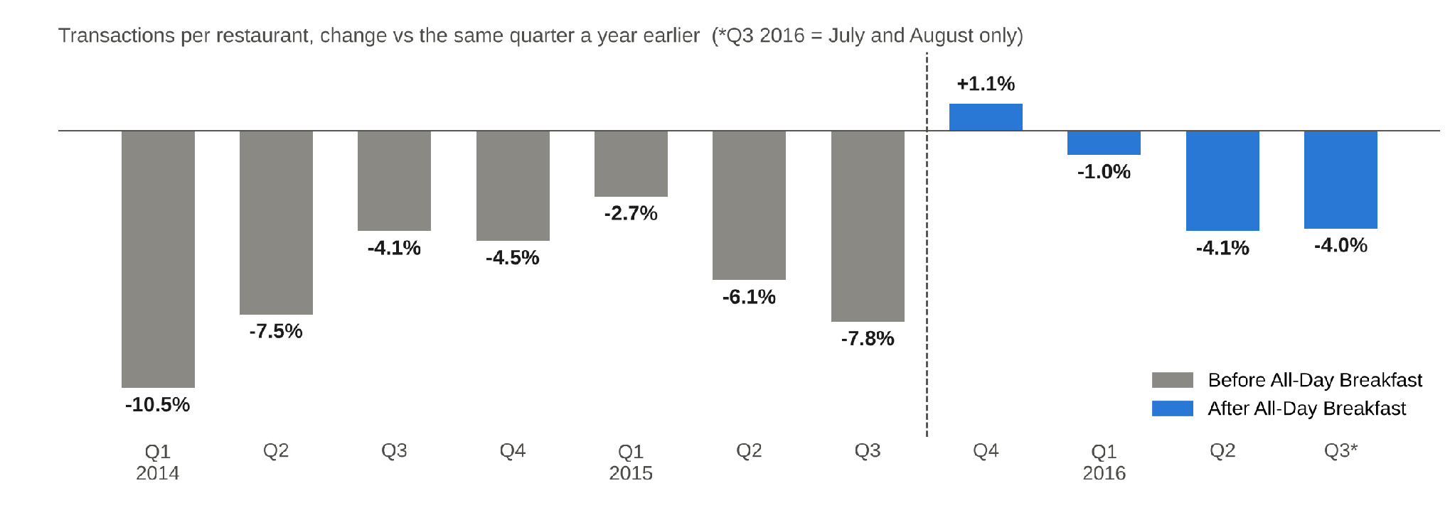
Intro
Problem
Data
Insights
Questions
Plan
Customer Traffic briefly turned positive after ADB launched, but declined again by mid-2016.
All-Day Breakfast on its own is not a lasting fix for the decline in customer traffic.
Source: McDonald's weekly sales extract, 64 West Michigan restaurants, Jan 2013 to Aug 2016; team analysis
8
Notes:
SPEAKER 2. This is the number you care about most. Each bar compares transactions with the same quarter a year earlier. Before launch, every quarter was down. In the quarter after launch, transactions rose 1.1%, the only increase in our data. By mid-2016 they were down about 4% again.

Slide 9
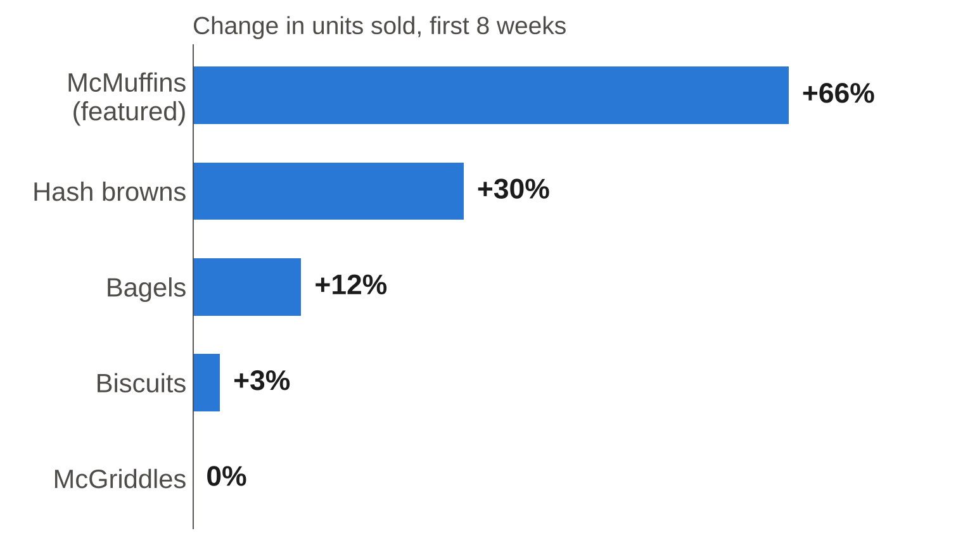
Intro
Problem
Data
Insights
Questions
Plan
McMuffins led post-launch revenue growth, while biscuits and McGriddles showed little or no change.
What it means
■ McMuffins saw the strongest unit growth
■ Same weeks last year: flat
■ Still 30% above last year in 2016
Option C: if biscuits and McGriddles grew as much as McMuffins did, revenue could rise about $0.8M per 8 weeks.
Source: McDonald's weekly sales extract, 64 West Michigan restaurants, Jan 2013 to Aug 2016; team analysis
9
Notes:
SPEAKER 2. McMuffin sales rose 66% in the first eight weeks. Biscuits and McGriddles, not offered all day, barely moved. The same weeks last year were flat, so this isn't seasonal. If biscuits and McGriddles responded the same way, that's roughly 0.8 million dollars per eight weeks, before kitchen costs. An upper bound to test, not a forecast.

Slide 10
Intro
Problem
Data
Insights
Questions
Plan
Revenue rose 8.6% after launch, as Breakfast gains outweighed declines in Chicken and Fries.
+$2.0M
$0.7M
+$1.3M
−
=
Breakfast gain
Other items lost
Net gain (+8.6%)
Selected item-level revenue changes, first 8 weeks vs the 8 weeks before
▲ +$189K
▲ +$47K
▼ −$210K
▼ −$478K
Quarter Pounder
+19%
Big Mac
+6%
Fries
−6%
Chicken
−15%
The trade-down you worried about is in chicken and fries, not premium burgers.
Source: McDonald's weekly sales extract, 64 West Michigan restaurants, Jan 2013 to Aug 2016; team analysis
10
Notes:
SPEAKER 3. Across the 64 restaurants, breakfast added about 2 million dollars in the first eight weeks, and other items lost 0.7 million, so revenue rose 1.3 million, or 8.6%. The bottom row shows where that 0.7 million came from: chicken and fries. Quarter Pounder and Big Mac revenue actually went up. Chicken was already falling before launch, and the same weeks a year earlier were flat.

Slide 11
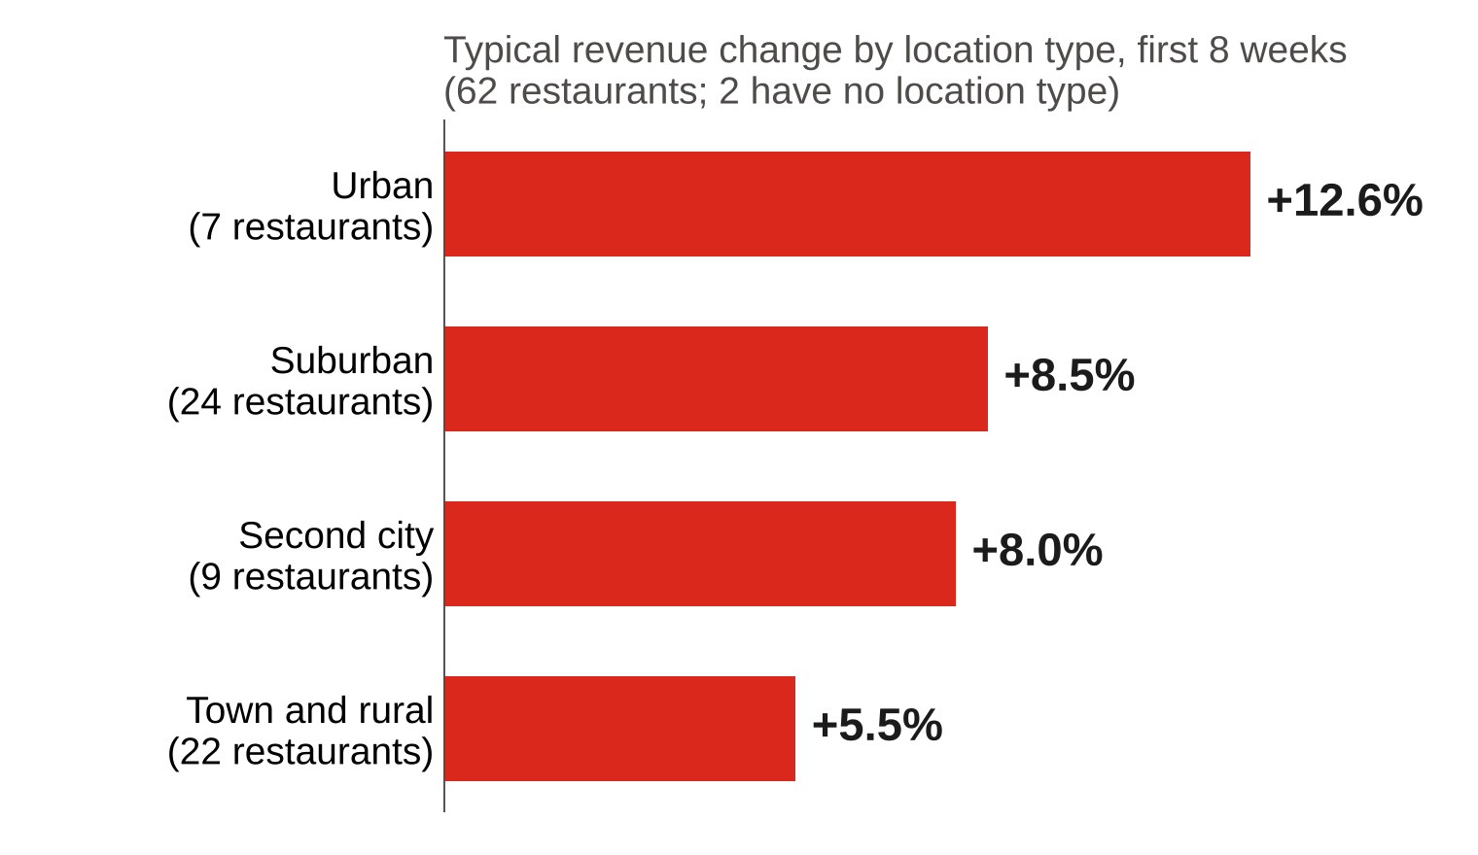
Intro
Problem
Data
Insights
Questions
Plan
Results vary by restaurant location type:
Urban locations gained the most
Also notable
■ Range: −8% to +27%
■ 10 of 22 Town restaurants grew less than 5%
■ All 7 Urban locations grew more than 5%
Urban locations performing best. Knowing why could be key to choosing between B and C.
Source: McDonald's weekly sales extract and restaurant facts file; team analysis
11
Notes:
SPEAKER 3. Every restaurant sold more breakfast, but net gains ranged from minus 8% to plus 27%. Urban restaurants gained about 13%, town and rural restaurants about 5.5%, and the five Traverse City area restaurants under 1%. Corporate restaurants gained slightly more than franchise ones, 9.7% versus 7.5%.

Slide 12
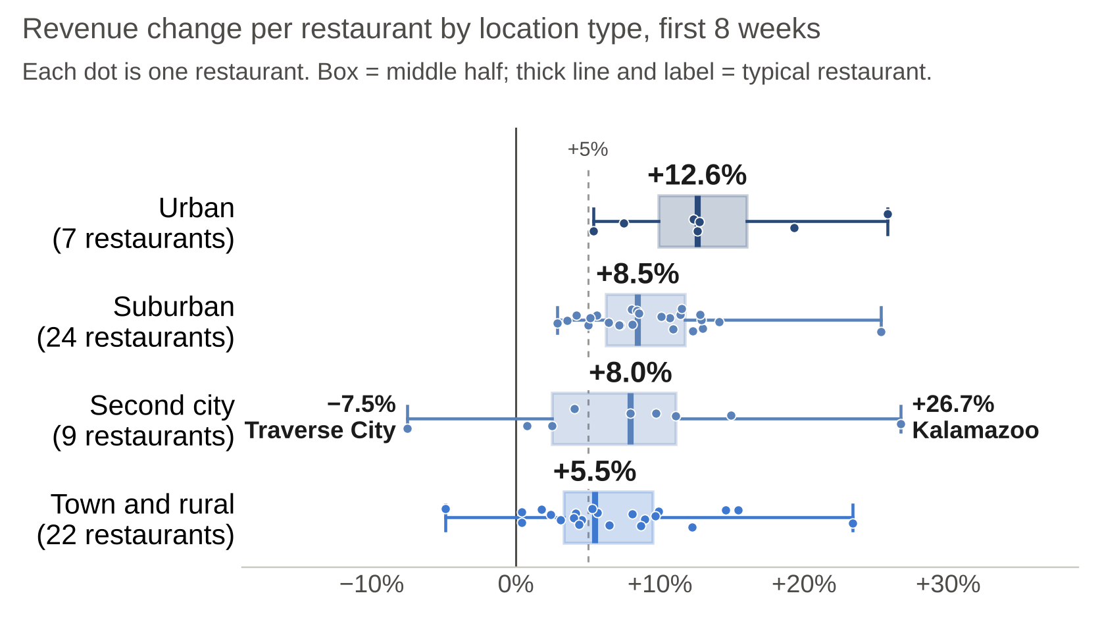
Intro
Problem
Data
Insights
Questions
Plan
Results vary by location type: urban locations gained the most, but every type had a wide range
Also notable
■ Range: −8% (Traverse City) to +27% (Kalamazoo), both second cities
■ 10 of 22 town and rural restaurants grew less than 5%
■ All 7 urban locations grew more than 5%
■ Every type had at least one restaurant above +20%
Urban performed best, but results vary widely within every type. Knowing why is key to choosing B or C.
Source: McDonald's weekly sales extract and restaurant facts file; team analysis
11
Notes:
SPEAKER 3. Every restaurant sold more breakfast, but net gains ranged from minus 8% to plus 27%. Urban restaurants gained about 13%, town and rural restaurants about 5.5%, and the five Traverse City area restaurants under 1%. Corporate restaurants gained slightly more than franchise ones, 9.7% versus 7.5%.

Slide 13
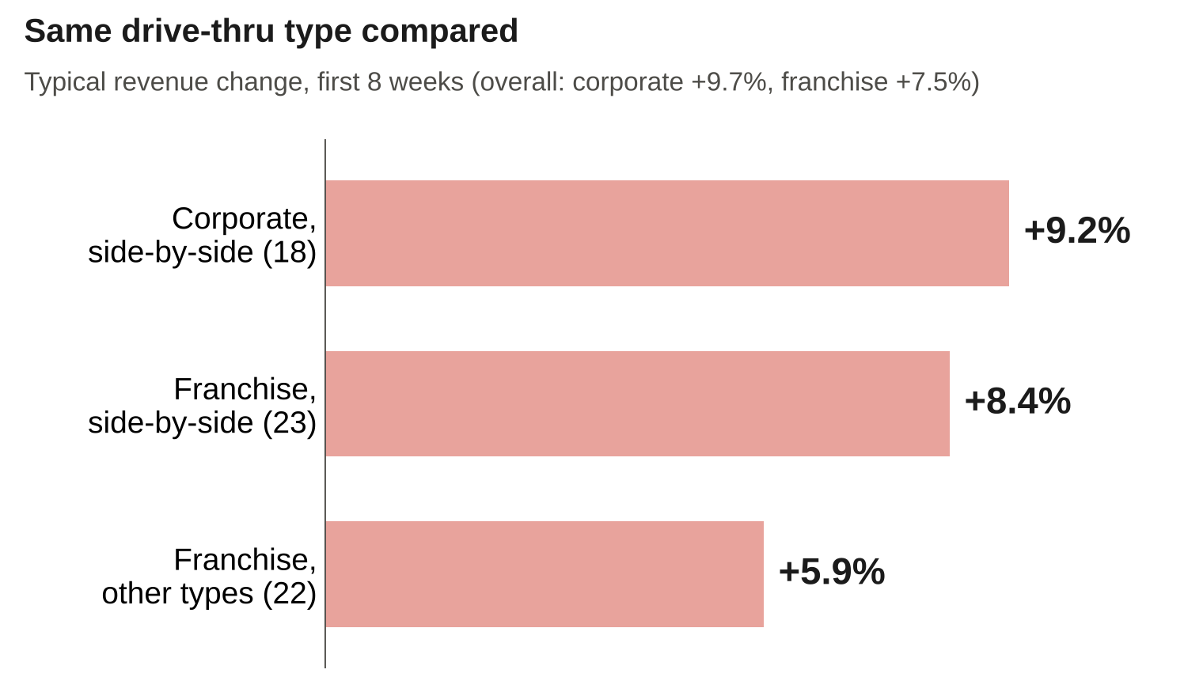
Intro
Problem
Data
Insights
Questions
Plan
Corporate restaurants gained more, and more consistently, than franchises; drive-thru type may explain much of the gap
About the franchises
■ 14 of 45 franchise locations grew under 5%
■ 3 of 19 corporate locations grew under 5%
This fits the mixed franchisee feedback. Visiting a strong and a weak franchise will show whether drive-thru type is the reason.
Source: McDonald's weekly sales extract and restaurant facts file; team analysis
12
Notes:
SPEAKER 3. Every restaurant sold more breakfast, but net gains ranged from minus 8% to plus 27%. Urban restaurants gained about 13%, town and rural restaurants about 5.5%, and the five Traverse City area restaurants under 1%. Corporate restaurants gained slightly more than franchise ones, 9.7% versus 7.5%.

Slide 14
Intro
Problem
Data
Insights
Questions
Plan
Four questions for you and five formal requests
Questions for you
Our formal requests
■ Success for corporate: customers, revenue or profit?
■ Which other promotions overlapped? Any still running?
■ Were Hashbrowns part of the All-Day Menu sales?
■ Is expanding (option C) realistic?
■ Data access through Rita
■ 2 site visits
■ Calls with 4 franchisees
■ 30 min with operations lead
■ 30 min with corporate
Most important: What is corporates success criteria.
Source: kickoff conversation with the regional manager; team analysis
12
Notes:
SPEAKER 3. On the left, questions only you can answer, starting with what corporate counts as success. We also heard on your call that a promotion may still be running. On the right, our formal requests: data through Rita, two site visits, franchisee calls, and short meetings with your operations lead and corporate sponsor.

Slide 15
Intro
Problem
Data
Insights
Questions
Plan
Next steps: five actions from your team to keep the timeline on track
Action | Owner | By
Approve data requests; share cost and margin by item | You and Rita | Oct 29
Share promotion calendar, hourly and full-menu sales data | Rita, Marketing | Oct 29
Arrange site visits and franchise owner interviews | You | Nov 6
Confirm corporate's success criteria | You, Regional Manager | Nov 6
Final readout | You, Regional Manager | Dec 18
Today's ask: approve the data requests by October 29.
Source: team work plan
13
Notes:
SPEAKER 1. To close: revenue is up through McMuffins and premium burgers held up, but the customer gain was short-lived and profit is unknown. With these five actions, you'll have a pull, keep or expand recommendation by December 18. Today's ask is approval of the data requests by October 22. Thank you; we're happy to take questions.

Slide 16
Intro
Problem
Data
Insights
Questions
Plan
Our plan delivers a recommendation by December 18, two weeks before your January 1 deadline
Oct 15
Oct 29
Nov 12
Nov 26
Dec 10
Dec 24
Jan 1
Approve Data Requests
Arrange site visits and franchise owner interviews
Analyze data and judge options A/B/C
Recommendation
Buffer (holidays)
Data in hand
Oct 29
Final
Dec 18
Corporate
Jan 1
78 days in total. The holiday weeks are buffer, so a late data delivery doesn't put January 1st at risk.
Source: team work plan
14
Notes:
SPEAKER 1. Four phases over 78 days: get and validate the data, measure customer and profit impact, compare restaurants and size option C, then the recommendation. Interim readout November 20, final December 18.

Slide 17
Appendix
A. Definitions B. Menu structure C. Data quality detail
Notes:
Appendix: reference material for questions.

Slide 18
Appendix A
Appendix B
Appendix C
Appendix A: All figures use one revenue definition and are checked against the same weeks a year earlier
Term | Definition
Revenue | Weekly units sold × weighted average price, summed over 4 category totals: Breakfast, Beef, Chicken, Fries
Launch date | Estimated about October 1, 2015, from the breakfast increase already present in the week ending Oct 3
8-week comparison | Weeks ending Aug 8 to Sep 26, 2015 vs Oct 3 to Nov 21, 2015; all 64 restaurants
Normal change | Same weeks in 2014: breakfast −0.4%, other categories −0.7%; Quarter Pounder and Big Mac flat, chicken −6%, fries −1%
Transactions | Average daily transactions per restaurant; trends use the 59 restaurants open every week
Option C estimate | Biscuit and McGriddle revenue ($1.1M per 8 weeks) × McMuffin revenue growth (+68%); excludes kitchen costs and cannibalization
Source: McDonald's weekly sales extract, 64 West Michigan restaurants, Jan 2013 to Aug 2016; team analysis
16
Notes:
Reference only.

Slide 19
Appendix A
Appendix B
Appendix C
Appendix B: The 25 menu lines form four families; only the four category totals can be added together
Category total | Includes (listed in the data) | Listed share of total
Breakfast | Breakfast Sandwich (exactly McMuffins + Biscuits + McGriddles + Bagels) and Hashbrown | ≈ 89%
Beef | Large Burgers (Big Mac, Quarter Pounders), Hamburger, Cheeseburger, McDouble | ≈ 79%
Chicken | McChicken | ≈ 35%
Fries | No separate items | n/a
Source: McDonald's weekly sales extract, 64 West Michigan restaurants, Jan 2013 to Aug 2016; team analysis
17
Notes:
Reference only.

Slide 20
Appendix A
Appendix B
Appendix C
Appendix C: Every data quality issue we found is small and has a defined fix
Issue | Size | How we handle it
Missing restaurant-weeks | 130 of 12,096 (1.1%): 2 new stores, 2 ten-week closures, 1 gap | Left as missing; trends use 59 always-open stores
Limited menu at one store | Store 16773 never sells 8 biscuit, McGriddle and bagel items | Treated as not sold, not zero sales
Partial weeks | Holiday weeks (6 days) and 6 store-weeks with 1 to 3 days open | Compare daily averages
Totals mixed with items | Category totals include sub-totals and items | Add only the 4 category totals
Inconsistent transactions | 253 store-weeks (2.1%) differ across items | Use the median per store-week
Implausible price | Sausage Egg Biscuit at $5.53 at store 4077 (normally about $2.89) | Flagged for Rita to confirm
Missing restaurant facts | No demographics for 2 stores; 5 blank play-area values | Excluded only from those breakdowns
Source: McDonald's weekly sales extract and restaurant facts file; team analysis
18
Notes:
Reference only.

